Slide 1

NSC-R Workshops
Regular workshops
Once a month
Online
Open to all
Special or advanced skills
Led by specialists
Data decided by presenters
Non-repetitive
More structured
NSC-R Tidy Tuesday workshops
Once a month
Online
Open to all
Fundamental skills
Led by NSC-R workshop team members
Diverse open datasets
Repetitive
Less structured
NSC-R Workshops Team
Alex Trinidad ● Asier Moneva ● Franziska Yasrebi–de Kom ● Sam Langton ● Wim Bernasco

Slide 2
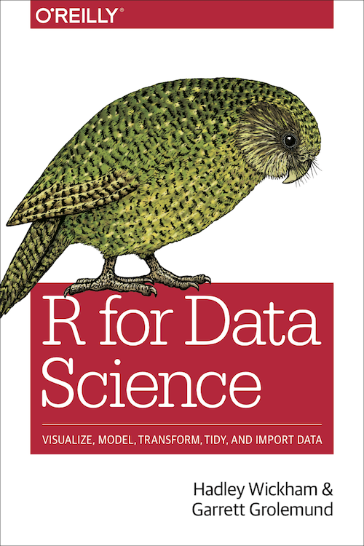
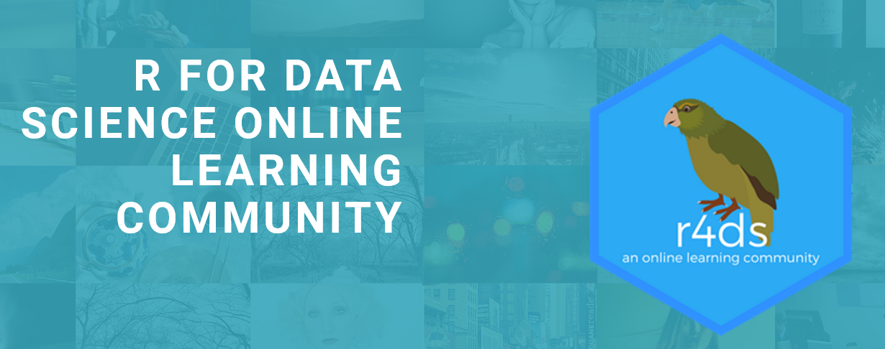
Inspirations
https://www.tidytuesday.com/
https://r4ds.had.co.nz
https://www.rfordatasci.com/

Slide 3
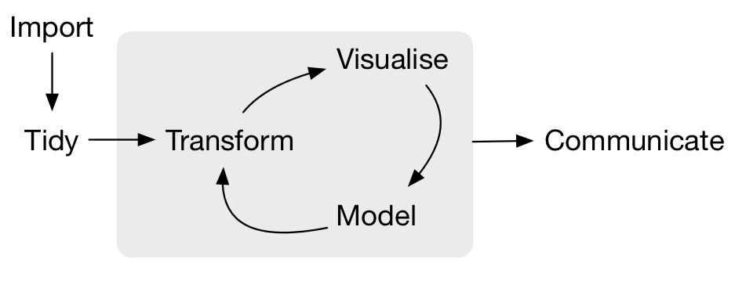
Data science workflow
Source

Slide 4
Mobility data (origin – destination)
Geographic examples
Residential mobility (prior home – current home)
Offending mobility (home – crime site)
Non-geographic examples
Intergenerational mobility (parents – children)
Communication (sender – receiver)

Slide 5
Erasmus+ student mobility program
Erasmus+ helps students study abroad.
Aims are improving communication, language and inter-cultural skills and gain soft skills.
Opportunities to study abroad are available to students at short cycle Bachelor and Master levels and Doctoral candidates.
Tidy Tuesday dataset on all exchanges funded 2014-2020. Note: this includes student mobility inside a single EU country.

